Slide 1



Introduction to Automated Electric Meter System
Automated electric meter systems leverage the power of IoT (Internet of Things) to revolutionize traditional metering processes. These advanced systems enable real-time data collection, remote monitoring, and optimized energy management for homes and management.

Slide 2

Overview of Traditional Meter Systems
Traditional electric meters, often referred to as analog or electromechanical meters, have been the primary means of measuring electricity consumption for decades. These meters use a spinning disk to track power usage, with the number of revolutions corresponding to the amount of energy consumed.

Slide 3

Limitations of Traditional Meter Systems
Manual meter reading: 📋 Traditional meters require periodic manual readings, leading to inaccuracies and inefficiencies.
Lack of real-time data: 🕰️ Analog meters provide limited visibility into energy usage patterns, hindering effective management.
Maintenance challenges: 🔧 Mechanical meters are susceptible to wear and tear, requiring frequent on-site maintenance.

Slide 4
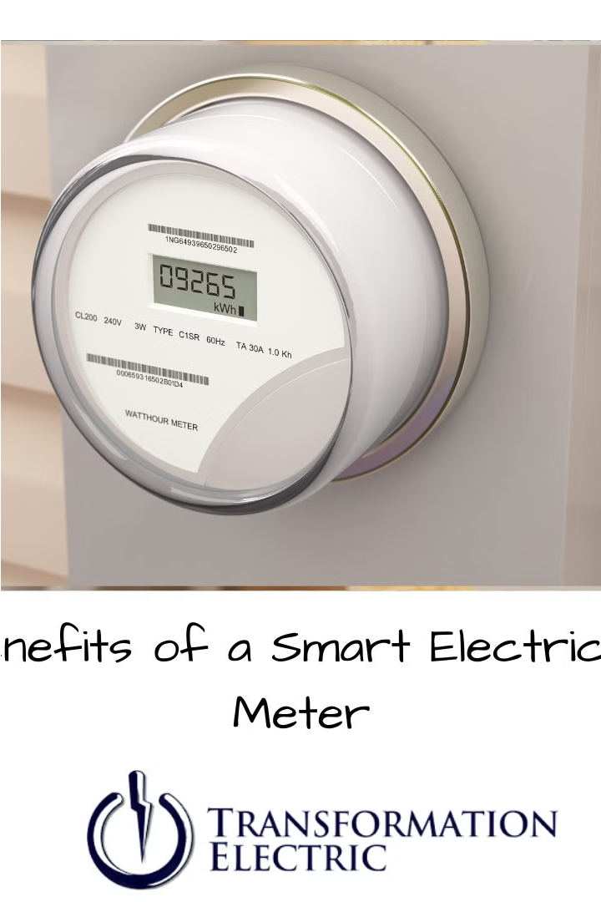
Benefits of Automated Meter Systems
Automated meter systems offer enhanced efficiency, improved data accuracy, and real-time visibility into energy consumption. They enable remote monitoring, streamlined billing, and proactive detection of issues to optimize resource management.
By automating the metering process, these systems reduce manual labor and human error, resulting in cost savings for utilities and customers alike.

Slide 5

IoT-based Automated Meter System
IoT-based automated meter systems leverage connected devices and cloud-based analytics to revolutionize electric metering. These advanced systems enable real-time data collection, remote monitoring, and intelligent energy management for homes and businesses.
By integrating smart meters, sensors, and communication modules, IoT-based systems provide unprecedented visibility and control over energy usage patterns.

Slide 6
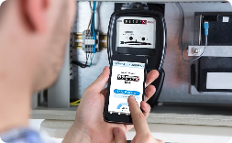
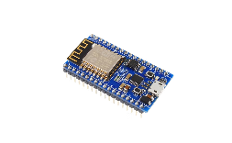
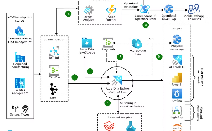
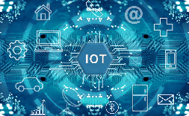
Components of IoT-based Automated Meter System
Smart Meters
Communication Modules
Cloud-based Analytics
Control Systems
Advanced digital meters that capture real-time energy usage data and communicate it wirelessly to the utility.
Integrated software and hardware that allow remote monitoring, management, and optimization of the entire metering infrastructure.
Embedded devices that enable two-way data transmission between smart meters and the central monitoring system.
Powerful data processing and visualization platforms that analyze energy consumption patterns and provide actionable insights.

Slide 7
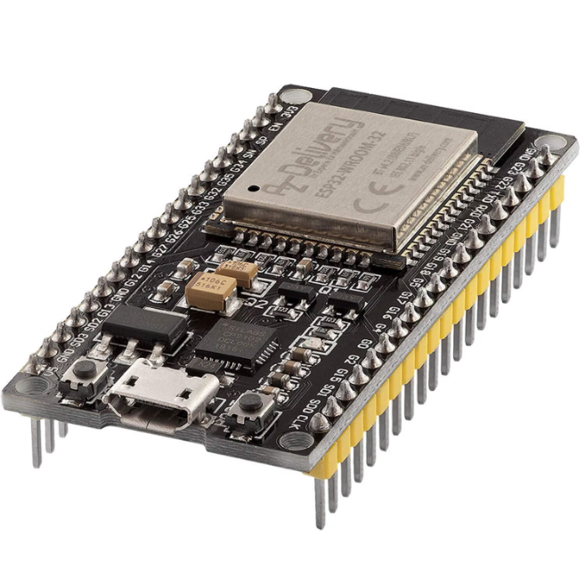
ESP 32
The ESP32 is a powerful microcontroller that is often used in IoT-based systems. It is equipped with Wi-Fi and Bluetooth capabilities, making it ideal for connecting devices to the internet and enabling communication between them. With its extensive range of features and functions, the ESP32 is a popular choice for developers working on automated metering systems.

Slide 8
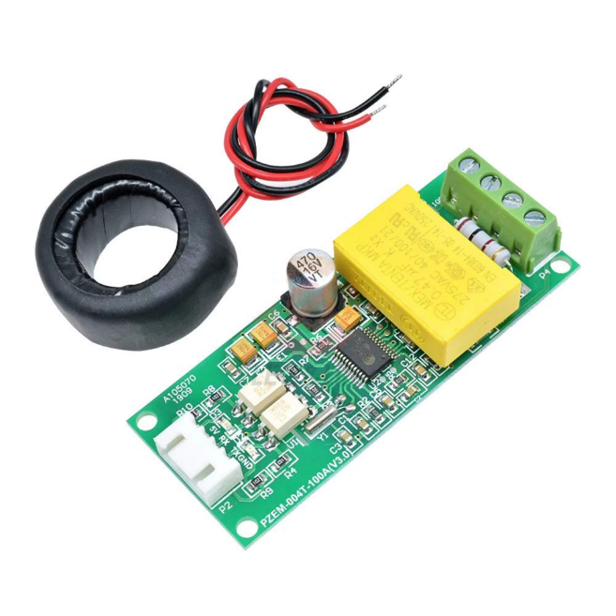
PZEM - 004T
The PZEM-004T is a versatile energy monitor module that is frequently used in conjunction with microcontrollers like the ESP32. It allows users to measure various electrical parameters such as voltage, current, power, and energy consumption. This module is compact, easy to use, and provides accurate readings, making it a valuable tool for monitoring and managing energy usage in IoT applications.

Slide 9

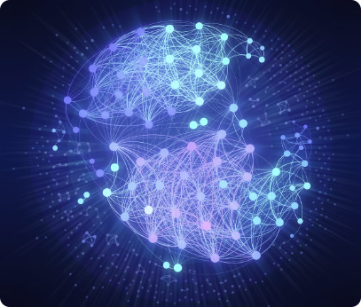
Data Collection and Transmission
1
Smart Meter Data
Smart meters continuously monitor and record electricity usage data in real-time.
2
Wireless Communication
Advanced communication modules transmit the metering data wirelessly to a central hub or cloud platform.
3
Secure Transmission
Encrypted protocols ensure the safe and reliable transfer of sensitive energy consumption information.

Slide 10
Real-time Monitoring and Analysis
Continuous Visibility
Predictive Analytics
Anomaly Detection
Customized Reporting
IoT-enabled automated meter systems provide real-time visibility into energy consumption patterns, allowing utilities and customers to monitor usage trends in near real-time.
Advanced analytics platforms leverage the collected data to identify peak usage periods, forecast future demand, and proactively address potential grid imbalances.
Automated meter systems can detect and alert on unusual spikes or drops in energy consumption, enabling swift response to issues like equipment failures or theft.
Intuitive dashboards and reports allow utilities and customers to access detailed energy usage information, supporting informed decision-making and optimization efforts.

Slide 11
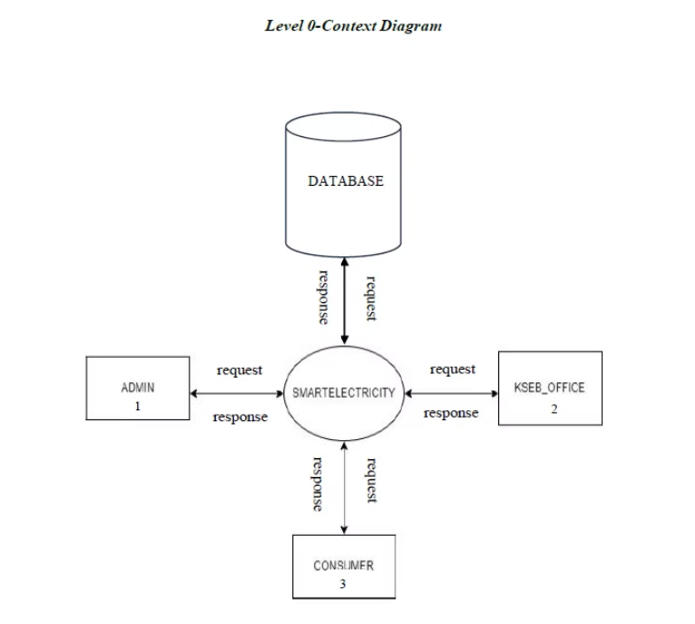
DFD- LEVEL 0- CONTEXT DIAGRAM

Slide 12
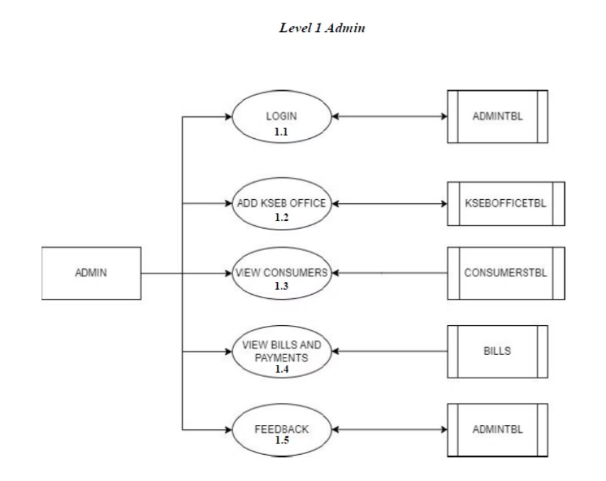
DFD- LEVEL 1 ADMIN

Slide 13
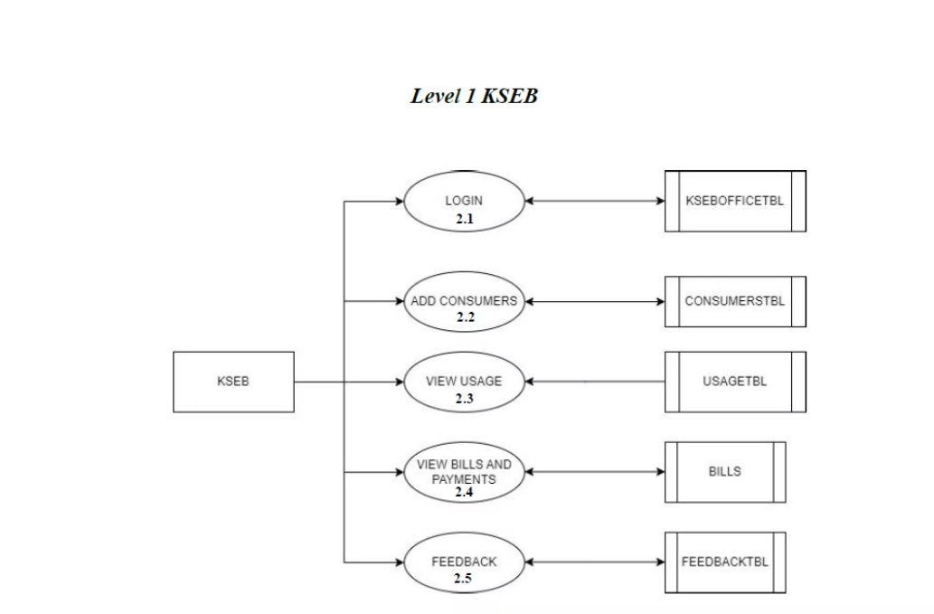
DFD- LEVEL 1 KSEB

Slide 14
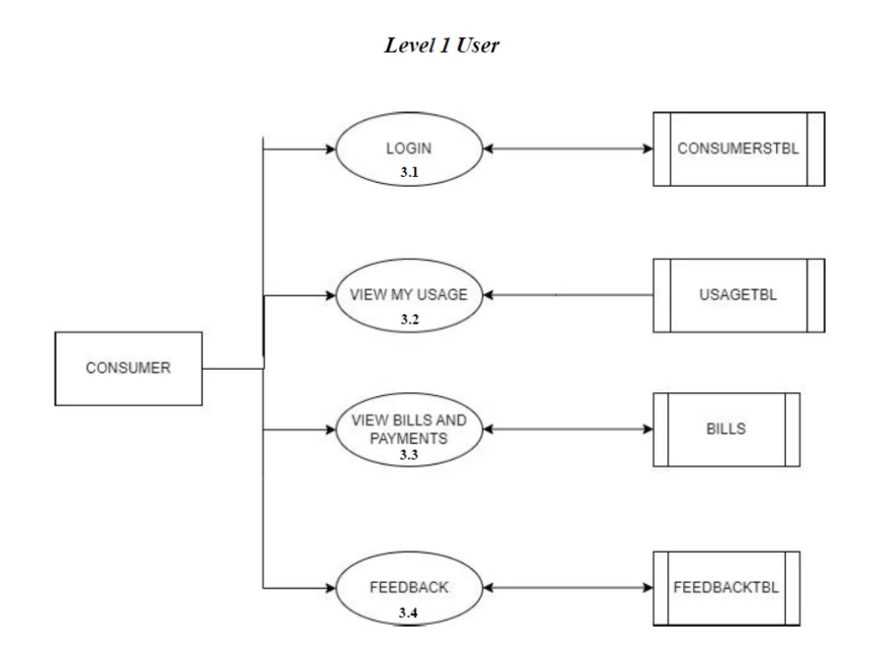
DFD- LEVEL 1 USER

Slide 15
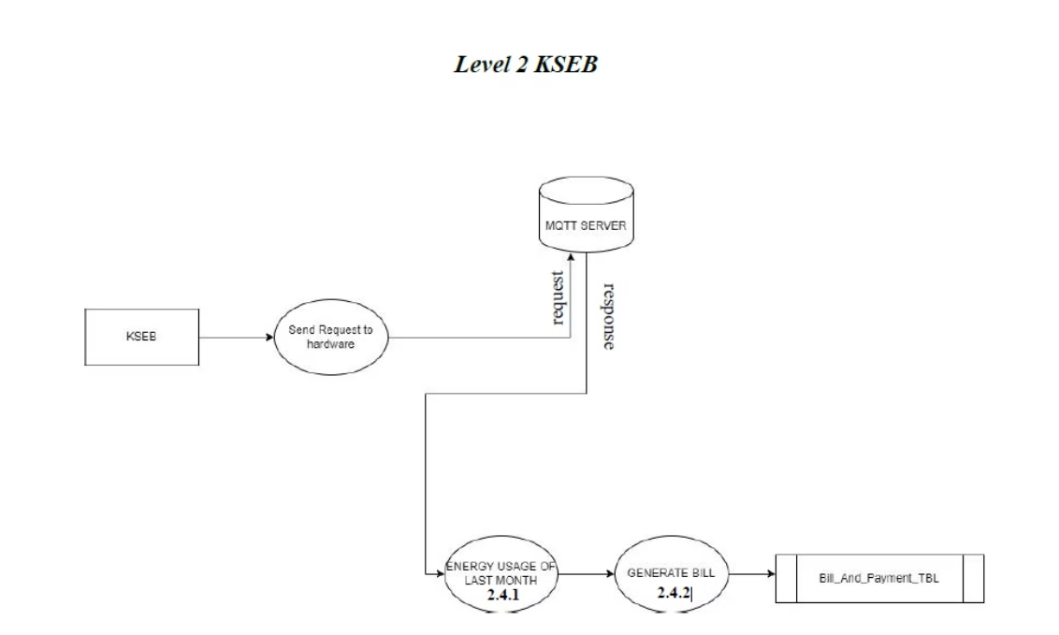
DFD- LEVEL 2 KSEB

Slide 16
Cost Savings and Efficiency ImprovementsDFD
1
Reduced Operating Costs
2
Optimized Energy Usage
IoT-based automated meter systems eliminate the need for costly manual meter readings, reducing labor and transportation expenses for utility companies.
Real-time data and advanced analytics allow customers and utilities to identify efficiency opportunities, leading to reduced energy consumption and lower utility bills.
3
Asset Lifetime Extension
4
Improved Revenue Collection
Predictive maintenance capabilities of IoT systems help extend the lifespan of grid infrastructure, deferring costly equipment replacements and upgrades.
Automated meters and tamper detection features minimize revenue losses from electricity theft and inaccurate billing, boosting the bottom line for utilities.

Slide 17
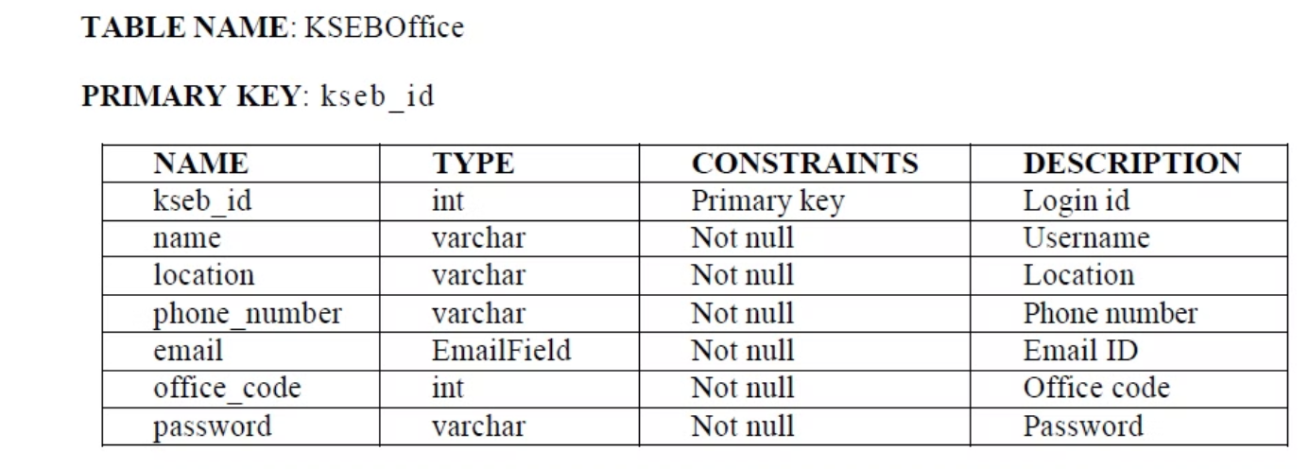
TABLES - KSEB OFFICE

Slide 18
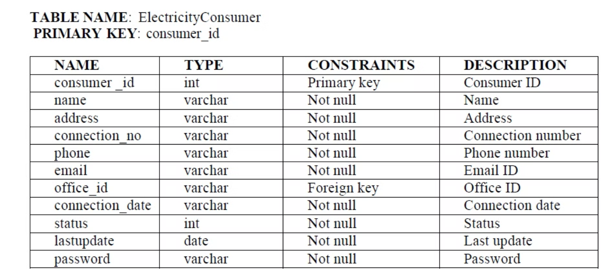
TABLES - ELECTRICITY CONSUMERS

Slide 19
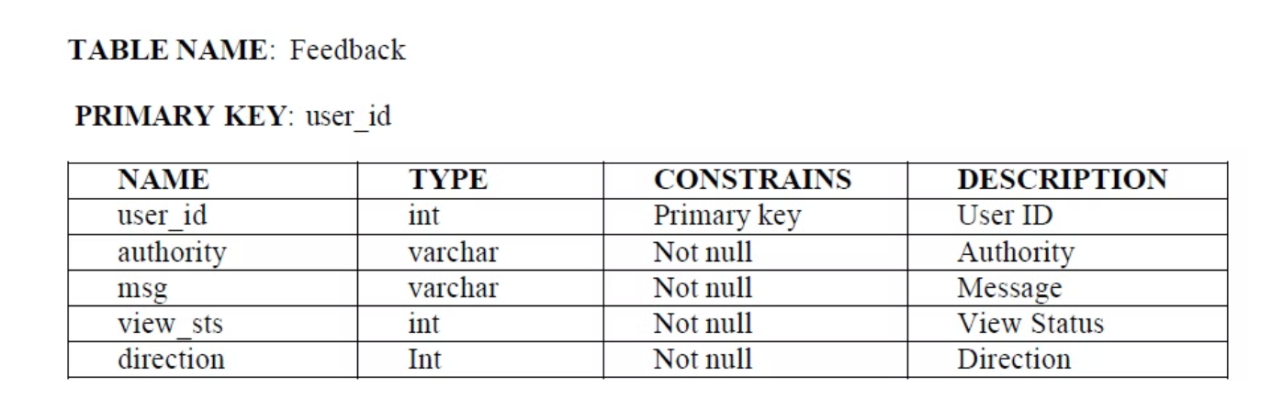
TABLES - FEEDBACKS

Slide 20
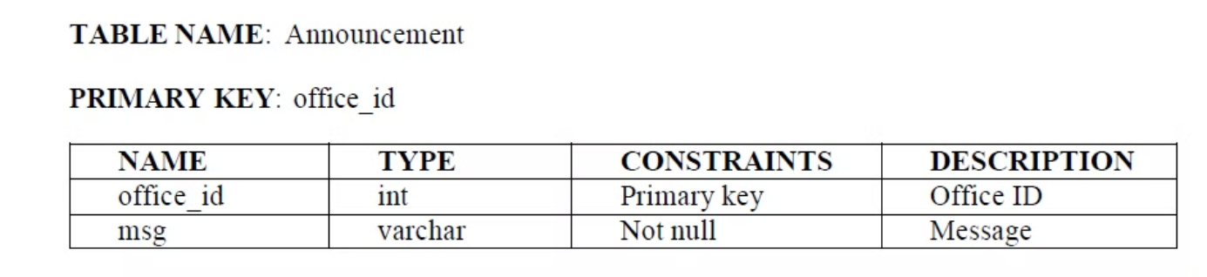
TABLES - ANNOUNCEMENT

Slide 21
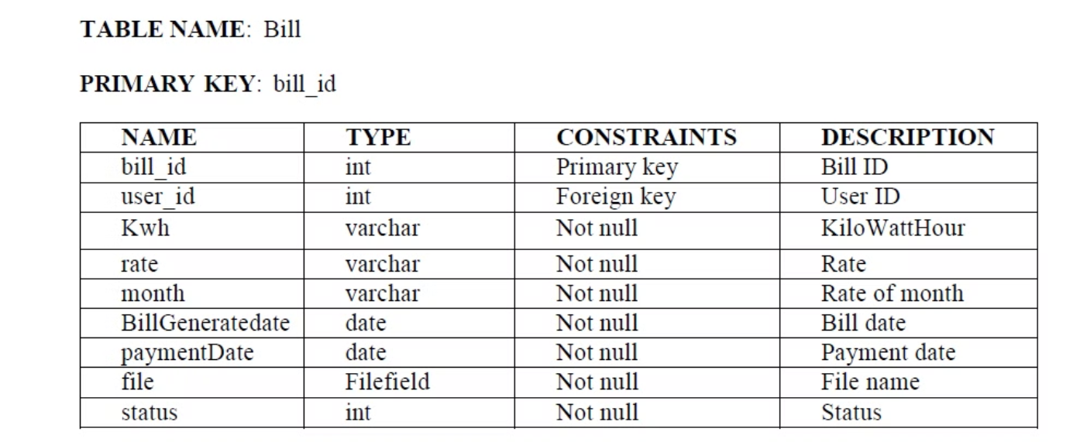
TABLES - BILLS

Slide 22
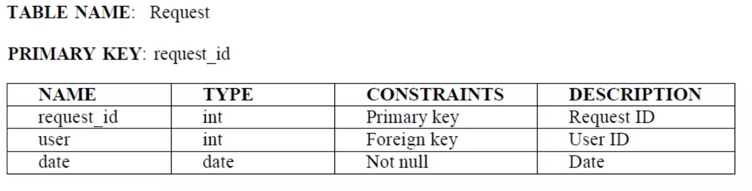
TABLES - REQUEST

Slide 23



Future Trends and Advancements
Grid Modernization
1
Integrating renewable energy and smart grid technologies
AI-powered Analytics
2
Leveraging machine learning for predictive maintenance
Blockchain-based Transactions
3
Enabling secure, decentralized energy trading
As the electric utility industry continues to evolve, the future of automated meter systems will be shaped by advancements in grid modernization, AI-powered analytics, and blockchain-based energy transactions. These innovations will unlock new levels of efficiency, transparency, and flexibility in energy management, empowering both utilities and consumers to optimize resource utilization and drive sustainable transformation.

